Slide 1
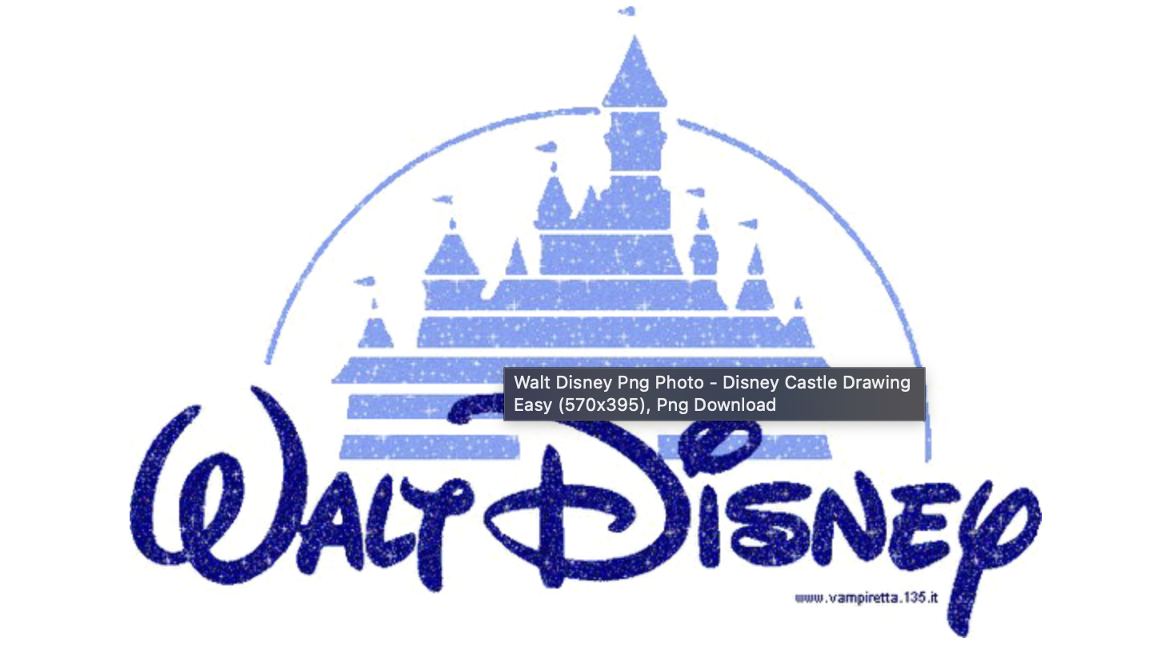
Can Disney Movie Contents Compete with Netflix?
A comparative study
Notes:
Covid hit hard on the movie theatre business but brought a lot of opportunity to internet steaming.
favorite brand
decision making business strategy
disrupt the market
shake the foundation of Netflix

Slide 2
Contents
Background
Research Question
Findings
Disney’s growth strategy going forward
Further discussions
Notes:
overview

Slide 3
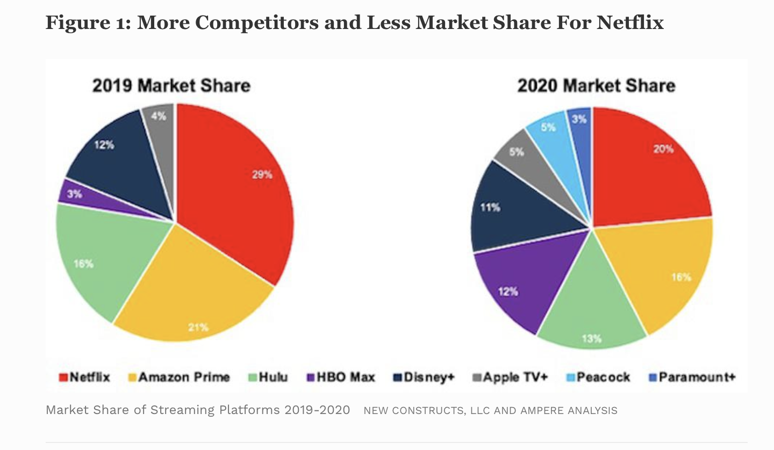
Background
Disney Plus is projected to overtake Netflix in overall subscribers by 2024 at the latest.
Picture comes from Forbes.com, May 10, 2021,09: Netflix: a Meme – Stock Original by David Trainer of Great Spectation Groups
Notes:
Talk about how the networks are different
There are very few shared titles between the two networks: 5 classic animations

Slide 4
Research Question
How do the movies in Disney plus network perform in terms of ratings as compared with Netflix’ movies of the same genres?
How should Disney Plus form its strategy going forward to maintain it’s competitiveness.

Slide 5
The Data
Disney plus data contains the data from October 2019 to May of 2020 by month
Netflix data contains movies dated from 1932 to 2021 by year
Metrics I used:
- IMDB Ratings
- Number of IMDB Votes
Notes:
Netflix is more like a movie database, where different production companies deposite their movies for viewers to see.
Disney plus contains movies that are original to the network and also its affiliates, hulu, espn, marvel, national geographics.
Metric of influence is the number of IMDB votes each network receives.
- - The votes are volunteer, I think it’s a good indicator of how far a movie title is able to reach to different demographics and parts of the world.

Slide 6
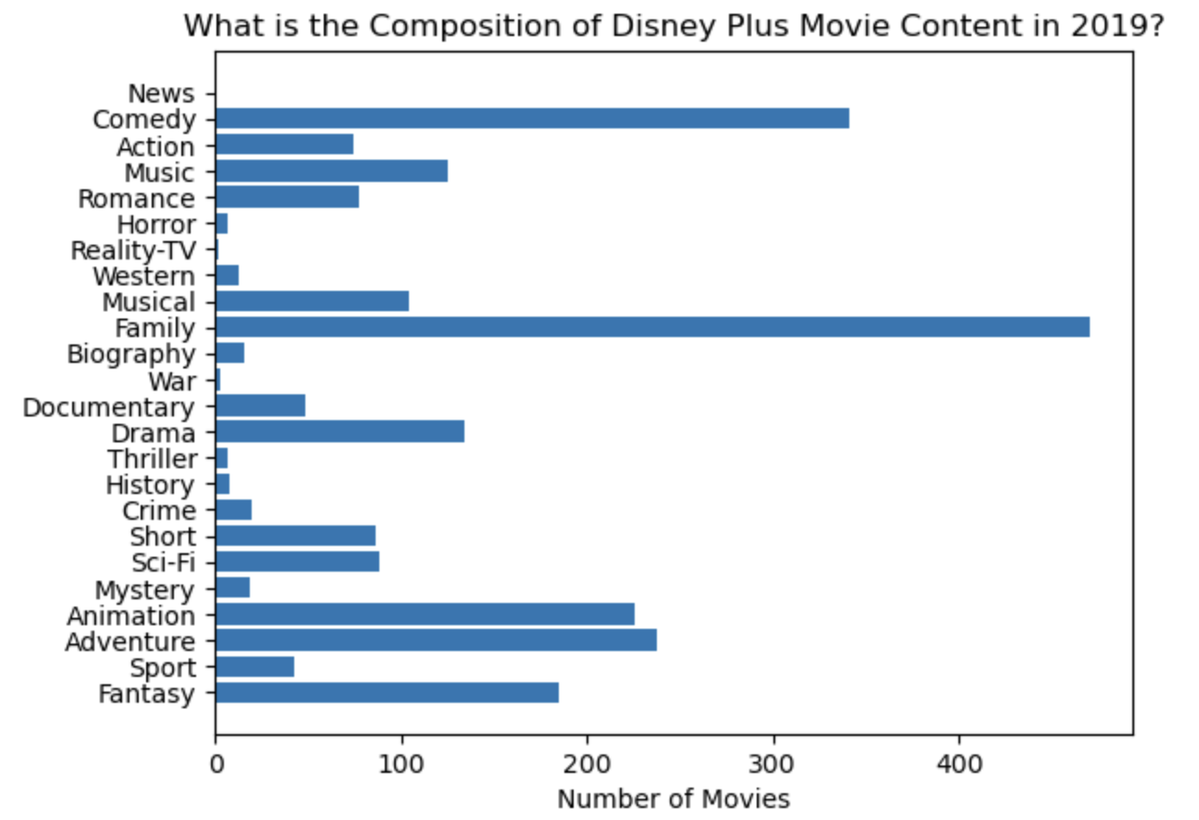
Contents of Disney Plus
Notes:
The 5 top most produced genres are family, Comedy, Adventure, Animationg and Fantasy.

Slide 7
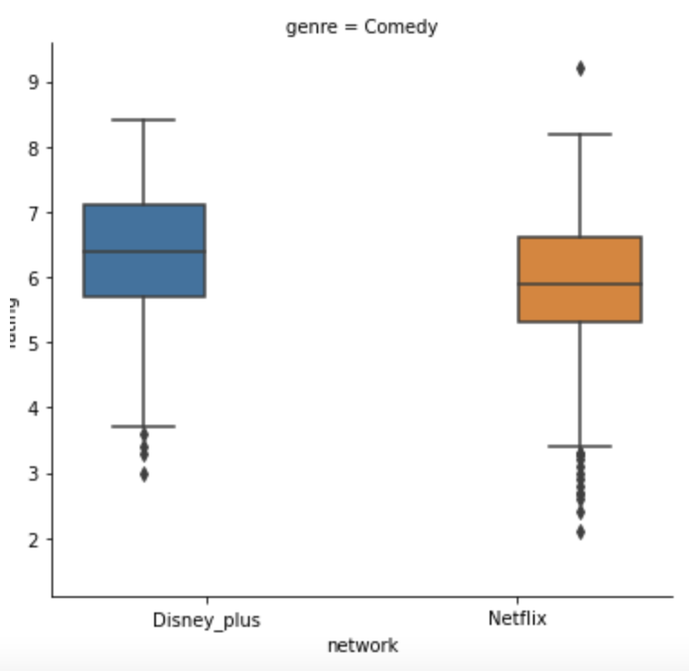
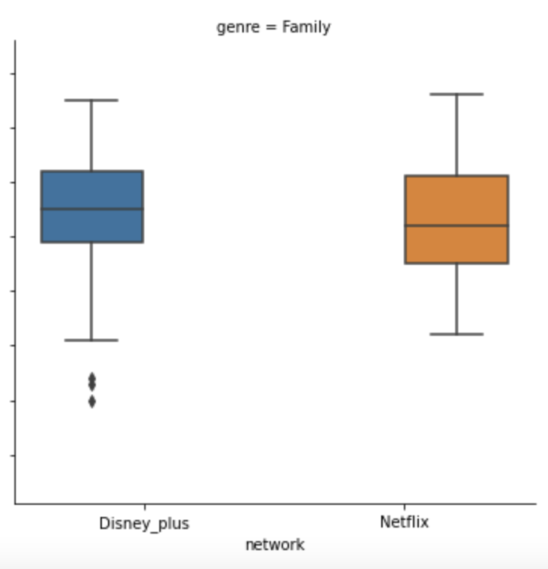
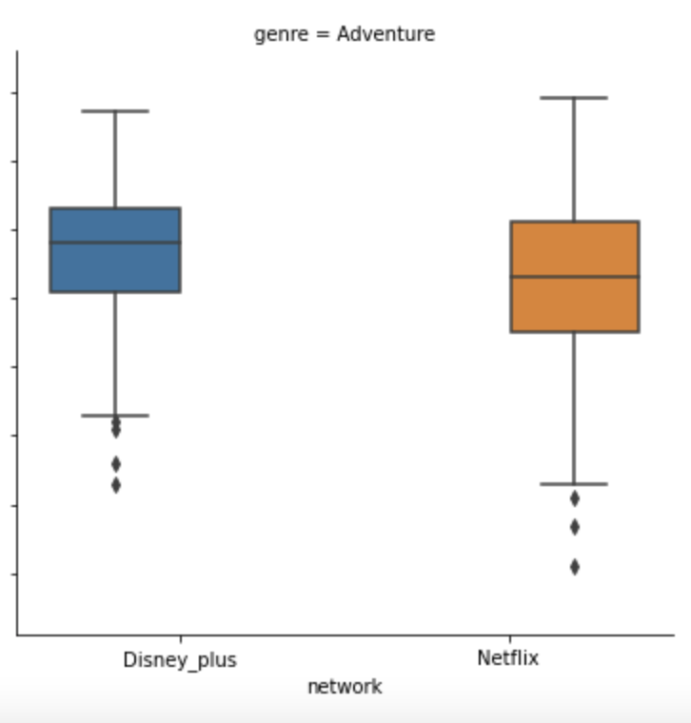
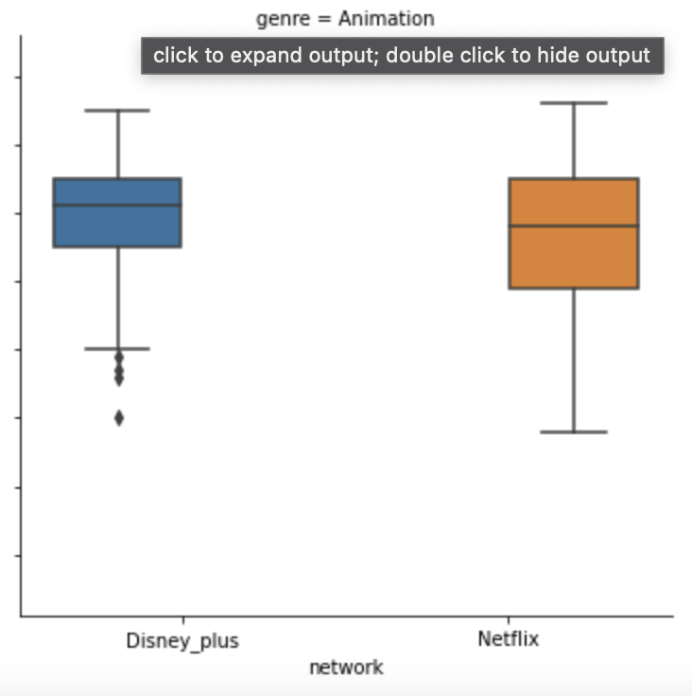
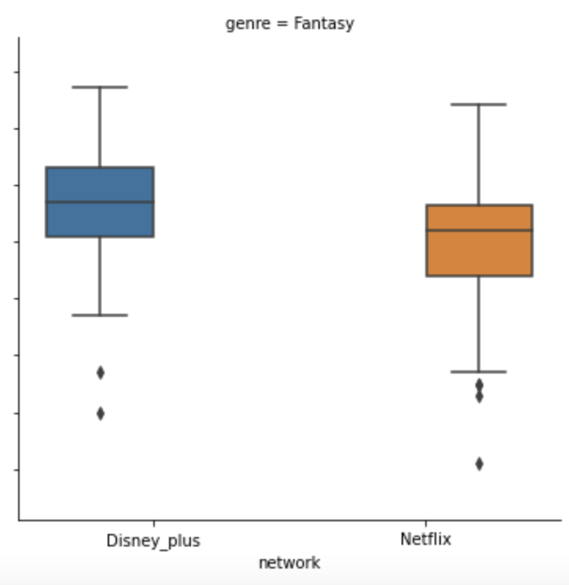
Ratings of the top 5 produced genres on Disney Plus, compared with Netflix: Families, Comedies, Adventures, Animations and Fantasies
Notes:
blue is disney, yellow is netflix
The colored box is where the middle 75% of view ratings are
In comedy and fantacy the difference to be more apparent

Slide 8
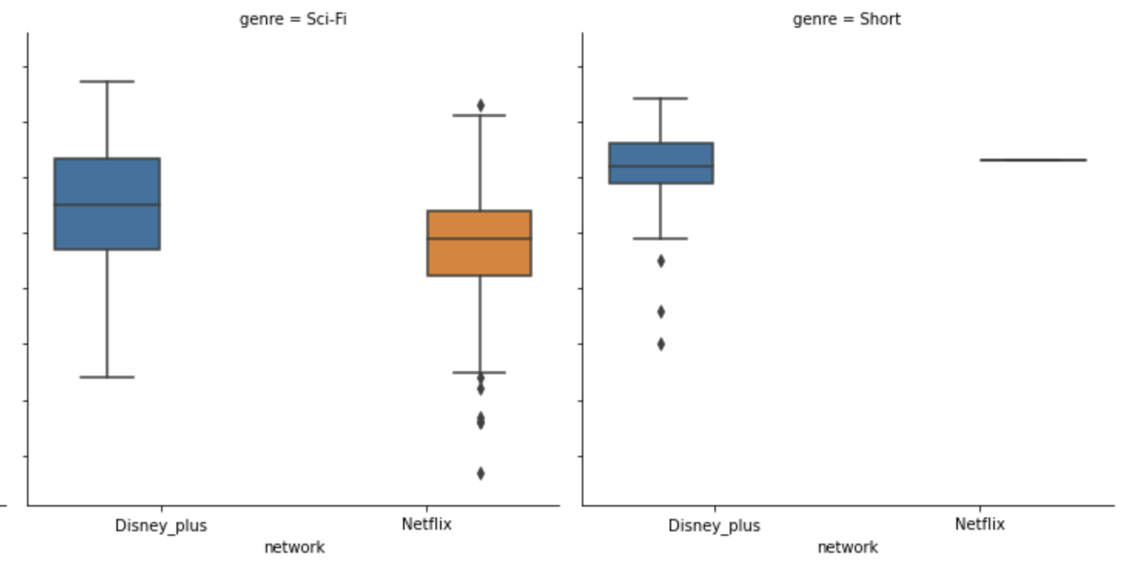
Additionally… Disney movies performance in these two categories are also worth noticing. .

Slide 9
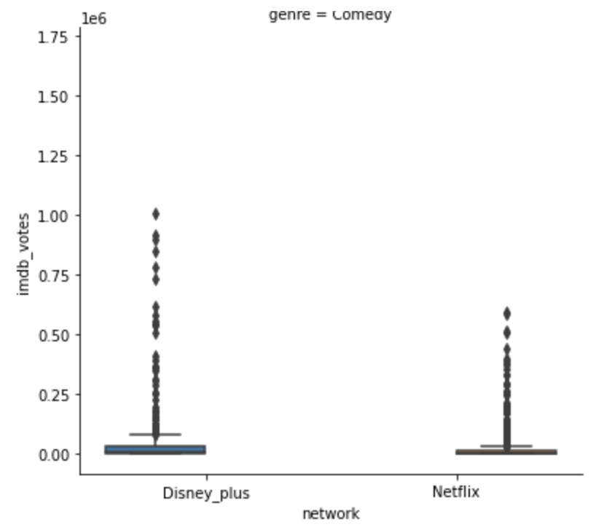
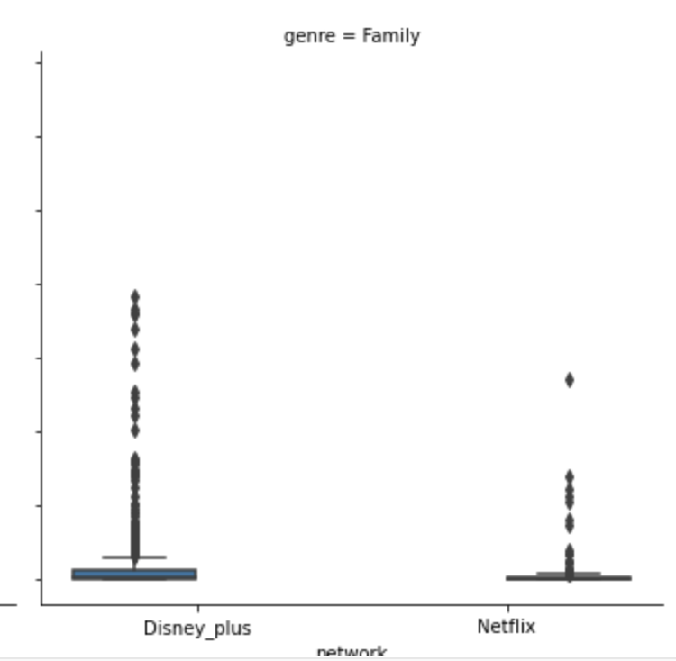
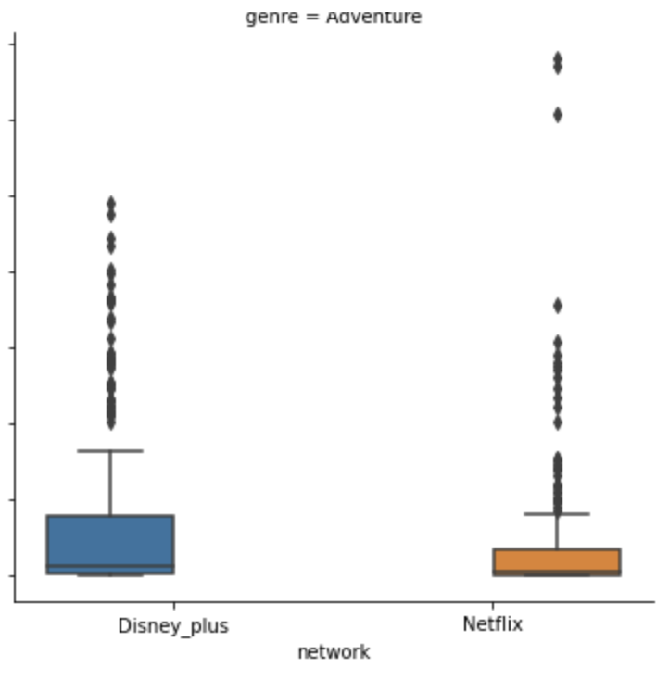
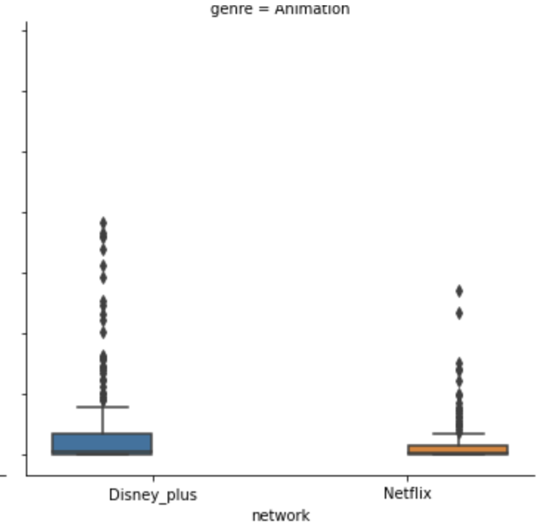
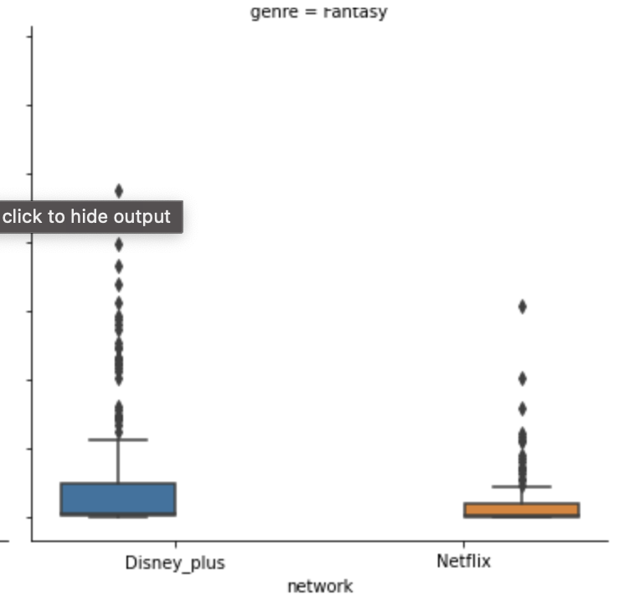
What about the influence of the network?

Slide 10
So what is Disney Plus’ strategy going forward to sustain its market share in the streaming business?
Disney Plus’ top producing genres also has grown in number, while maintaining higher IMDB ratings than Netflix.

Slide 11
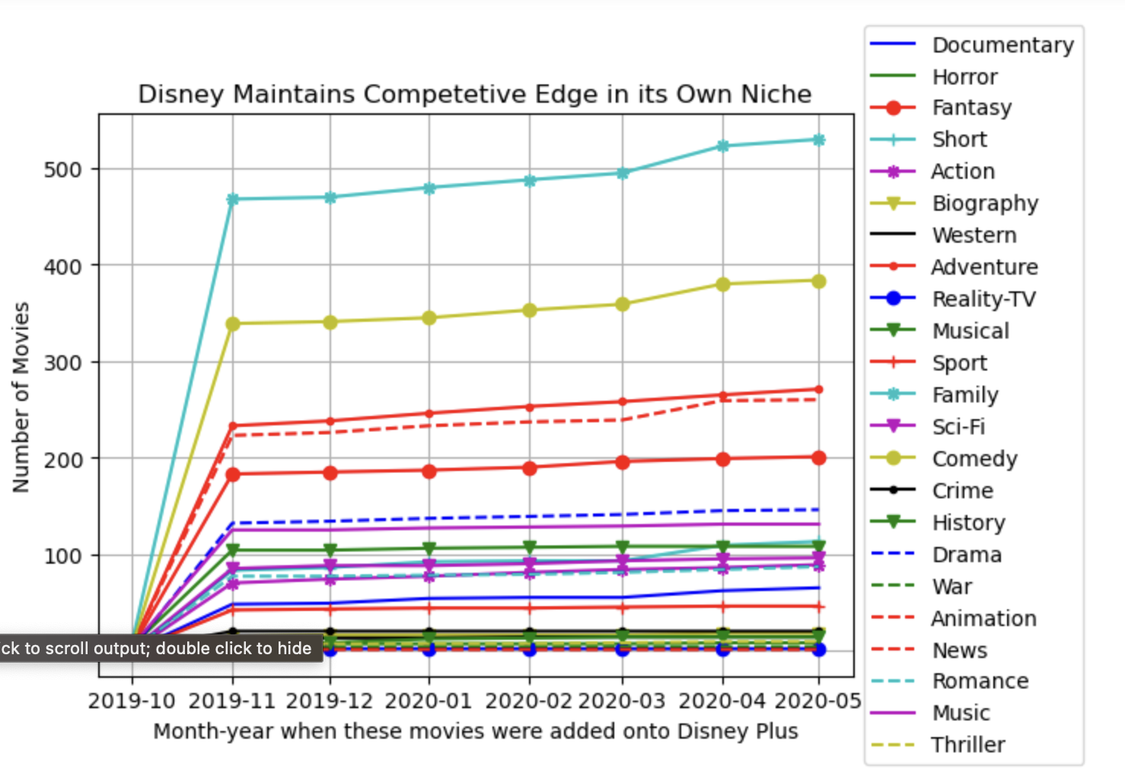

Slide 12
Grow Internationally
Network | is international? | rating
Disney _plus | Non-US | 6.37
 | US | 6.55
Netflix | Non-US | 6.11
 | US | 6.12
Network | is international? | number of movies
Disney _plus | Non-US | 144
 | US | 573
Netflix | Non-US | 1782
 | US | 1274
Notes:
to increase the appeal of disney contents

Slide 13
Next Steps
Integrate other metrics to evaluate the health of the network:
How the the length of the movies/TV shows affect ratings
Growth of subscription numbers
length of TV runtime analysis of the two networks.
A deeper dive into subtypes of products provided what affects the the viewship
How do viewers decide whether to see a movie on a big screen rather than streaming it? What are the factors that suggest a family might want to see a movie on the big screen?
Notes:
A main chunk of the streaming business is the TV. This is not addressed in my research.

Slide 14
Appendix
Kaggle Datasets:
Disney Plus Movie and TV shows by Raphael Fontes
Netflix Movie and TV shows by Snehaan Bhawal

